Slide 1
Electric Potential
Difference

Slide 2
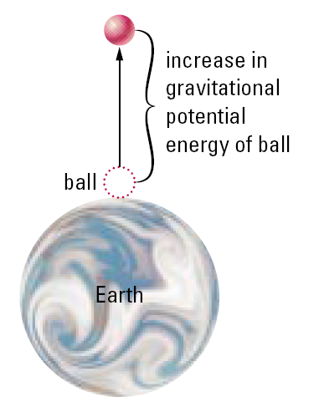
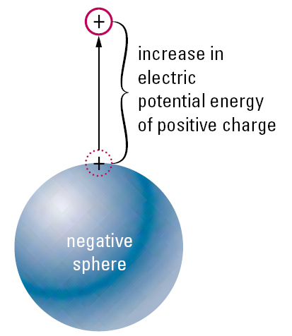

Slide 3

Electric Potential Difference
As current passes through the stove element, it experiences opposition to the flow, resulting in a loss of electric potential energy. The energy lost is transferred to the molecules and atoms of the conductor as the current moves through it. This causes the element to heat up and glow—electric potential energy has changed into heat and light energy.

Slide 4
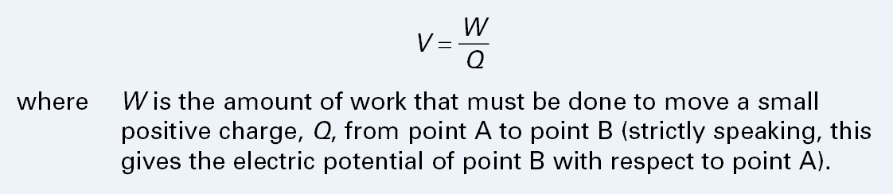
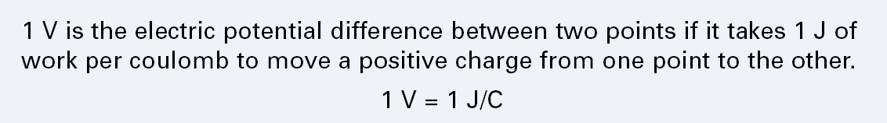
Electric Potential Difference

Slide 5
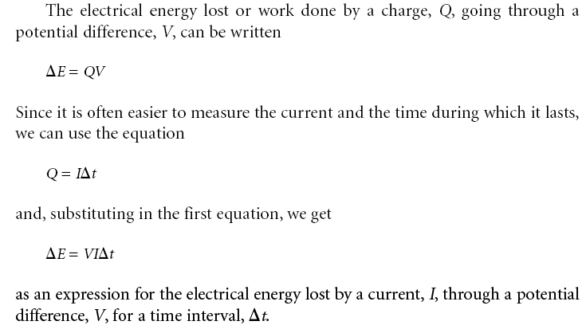
Electric Potential Difference

Slide 6
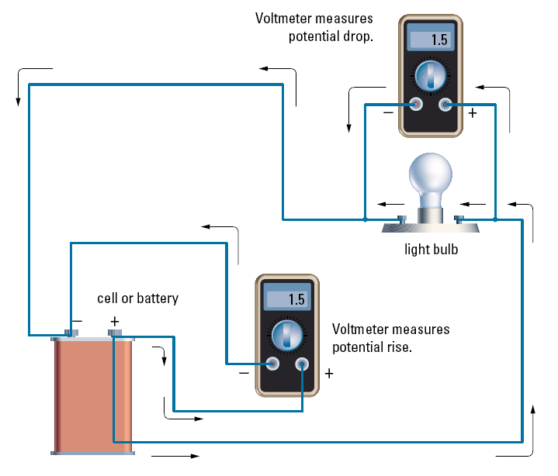
Electric Potential Difference

Slide 7
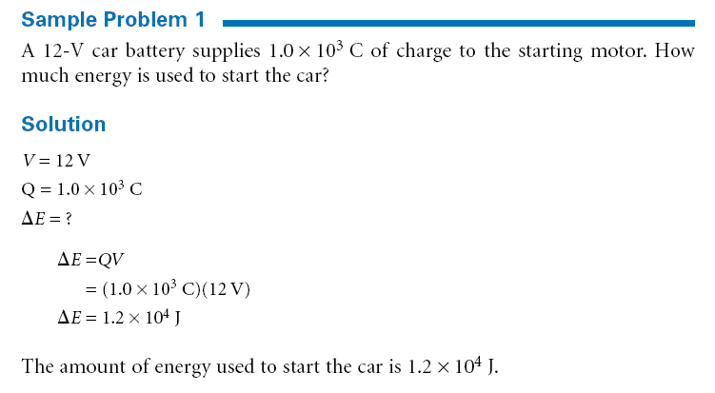
Electric Potential Difference

Slide 8
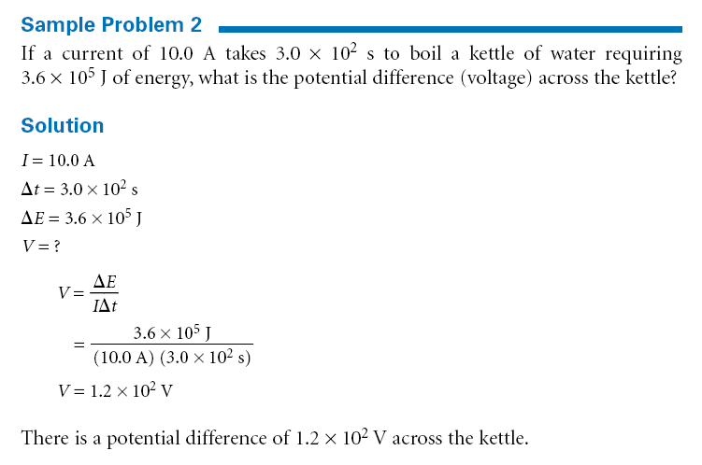
Electric Potential Difference

Slide 9
